Slide 1











BY
Pasindu Mahima
Search . . .
NGATOR
LEARNING
SAD PRESENTATIONS
learn.ngator.com

Slide 2




BY
Pasindu Mahima
Search . . .
IMPORTANT POINTS TO REMEMBER
JAVA GUI COMPONENTS
AND LAYOUTS
JAVA LIBRARIES
JAVA DATA STRUCTURES
BASIC PROCESSES
Arrays
Vectors
HashMap
Java AWT Components
Java Swing Components
Adding data to a Table
Adding items to a Combo Box
MySQL
Jasper Reporting

Slide 3
BY
Pasindu Mahima
Search . . .
JAVAX.SWING COMPONENTS
1.JFrame
2.JPanel
3.JLabel
4.JButton
5.JComboBox
6.JTable
7.JTextField
8.JPasswordField
9.JTextArea
10.JFormattedField
11.JList
12.JTabbedPane

Slide 4
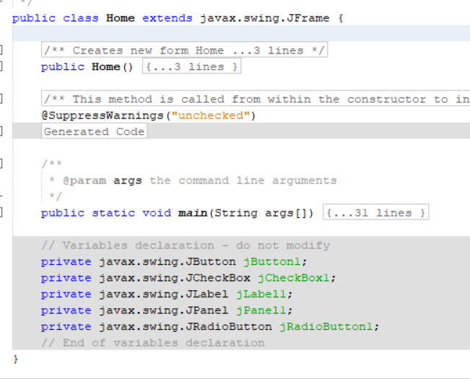
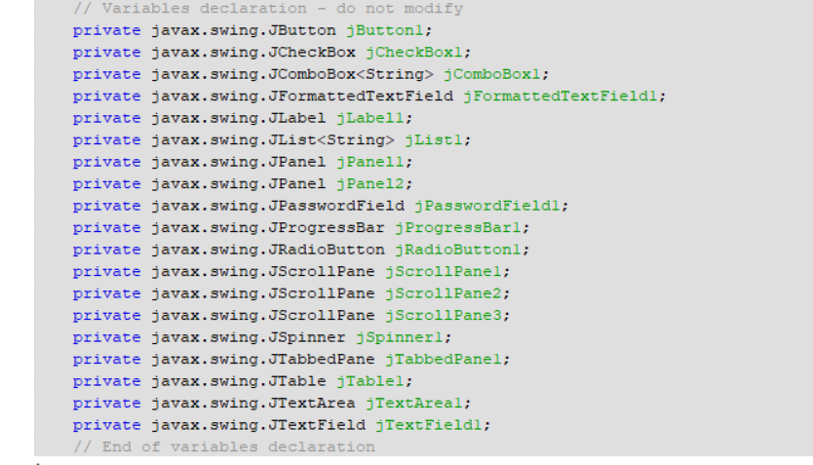
BY
Pasindu Mahima
Search . . .
javax.swing.JFrame
Component Initialization

Slide 5
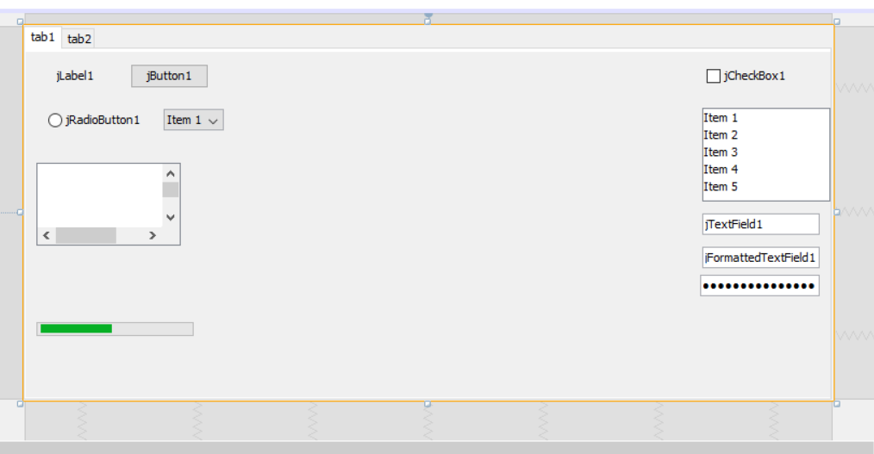
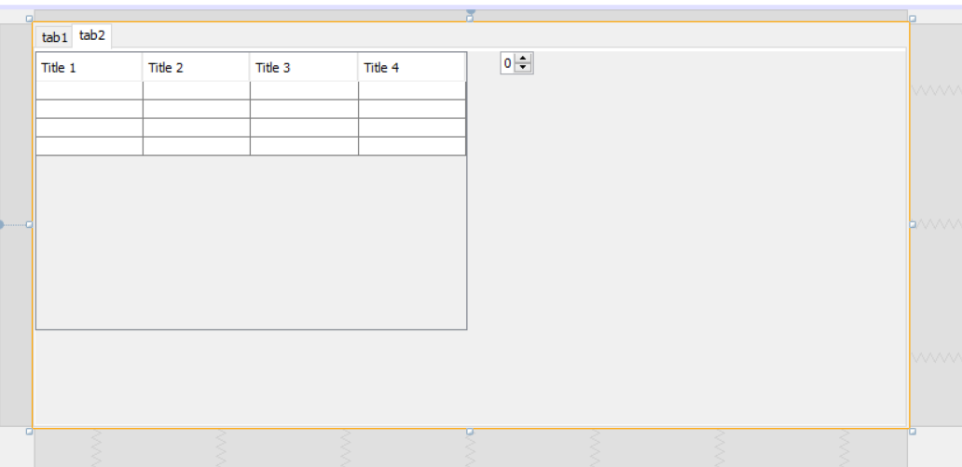
BY
Pasindu Mahima
Search . . .
javax.swing.JFrame

Slide 6
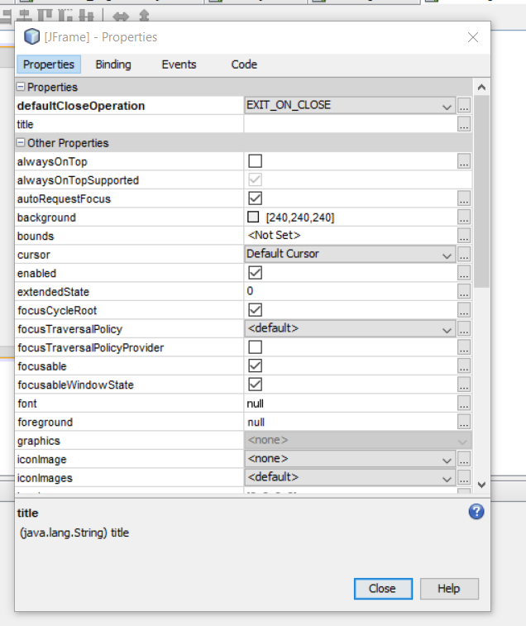
BY
Pasindu Mahima
Search . . .
javax.swing.JFrame

Slide 7
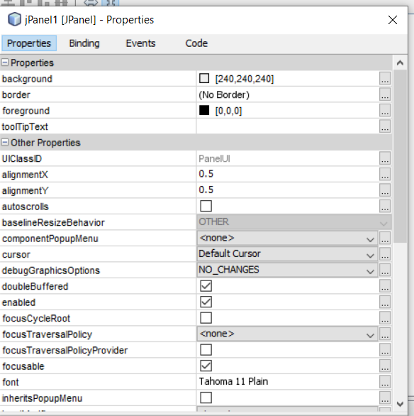
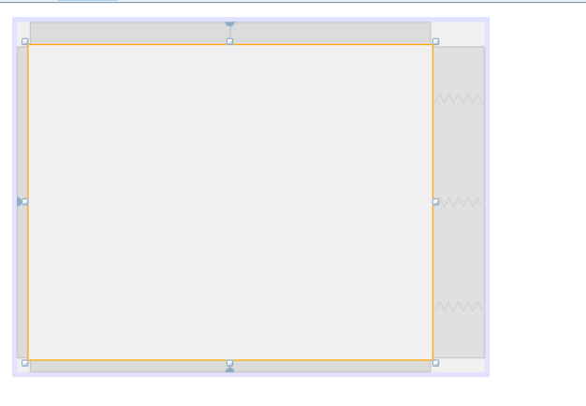
BY
Pasindu Mahima
Search . . .
javax.swing.JPanel

Slide 8
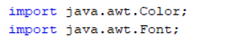
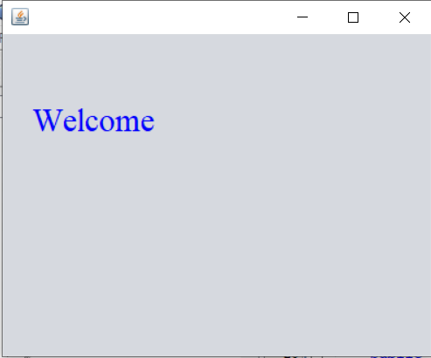
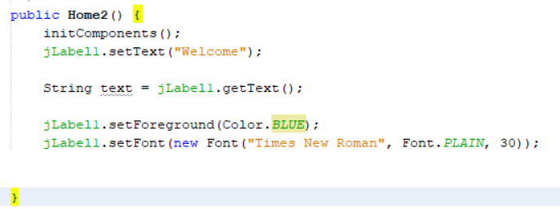
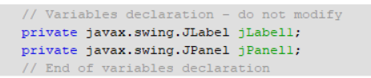
BY
Pasindu Mahima
Search . . .
javax.swing.JLabel

Slide 9
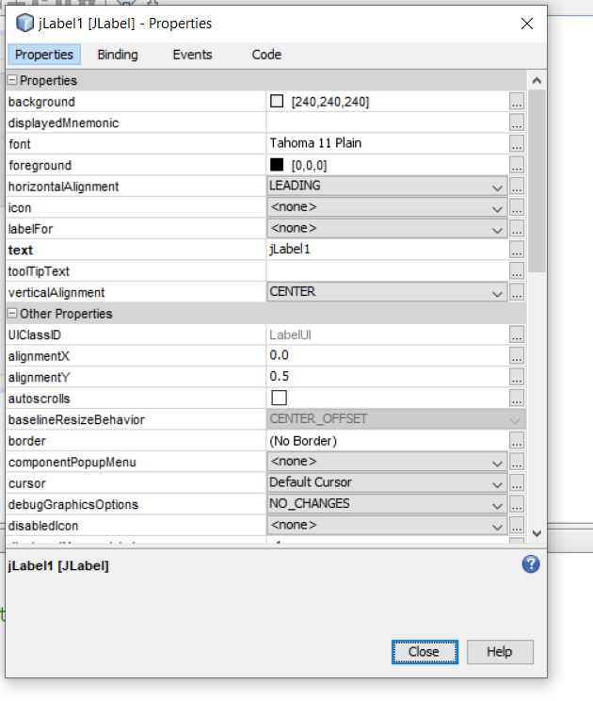
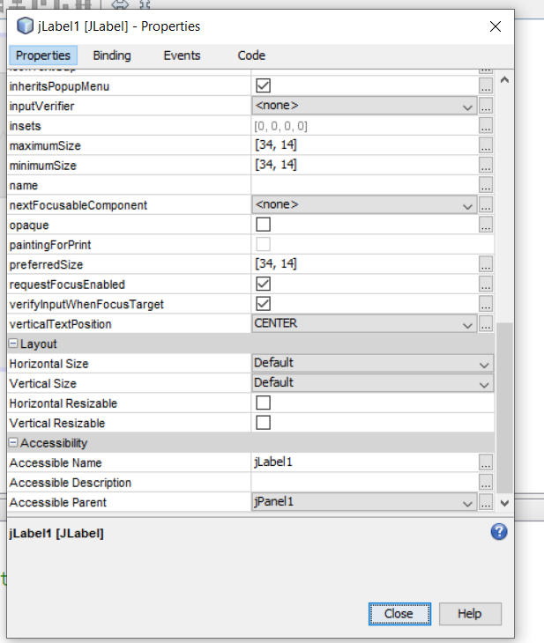
BY
Pasindu Mahima
Search . . .
javax.swing.JLabel

Slide 10
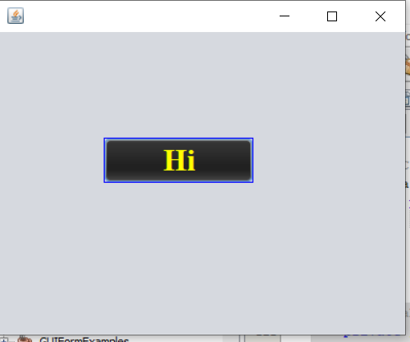
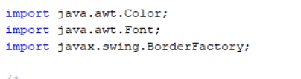
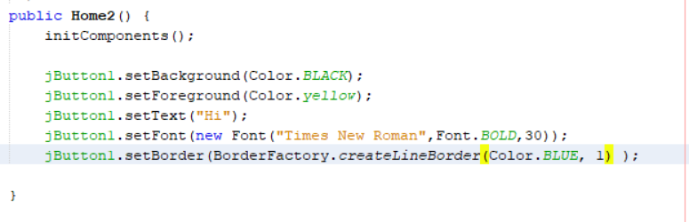
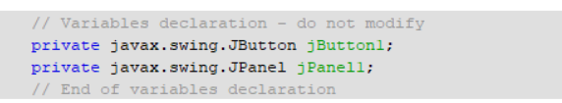
BY
Pasindu Mahima
Search . . .
javax.swing.JButton

Slide 11
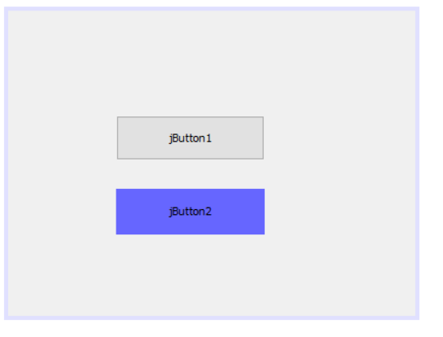
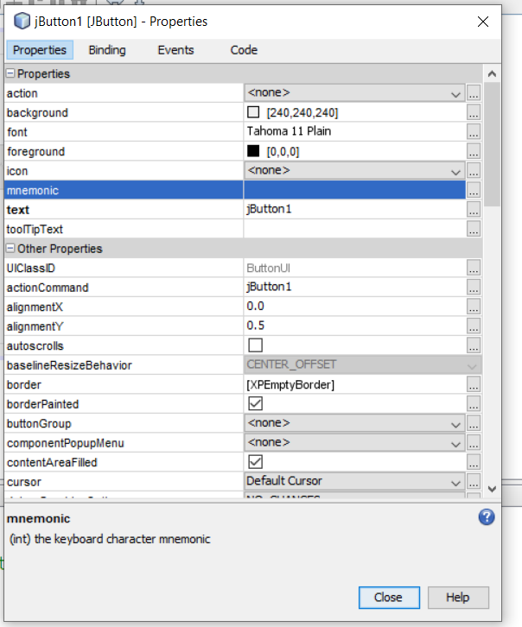
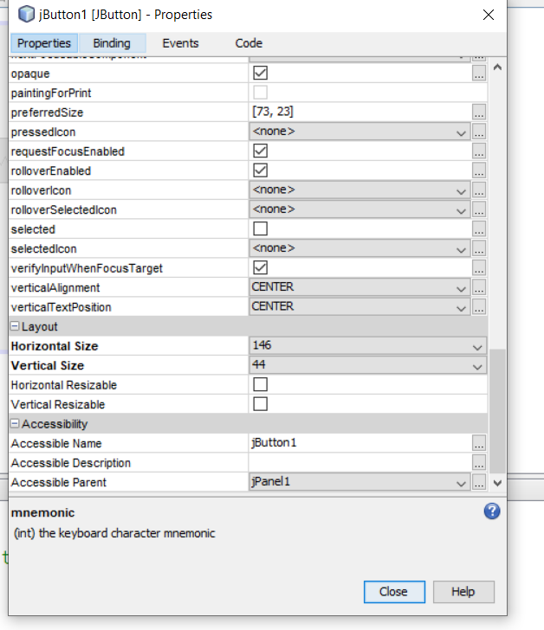
BY
Pasindu Mahima
Search . . .
javax.swing.JButton
ContentAreaField - Untick
Opaque - Tick

Slide 12
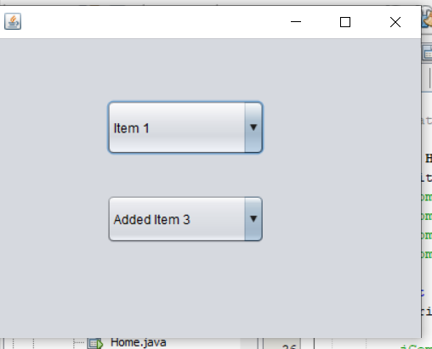
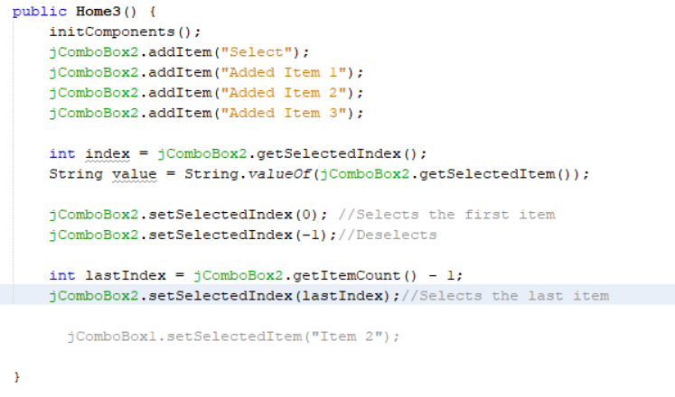
BY
Pasindu Mahima
Search . . .
javax.swing.JComboBox

Slide 13
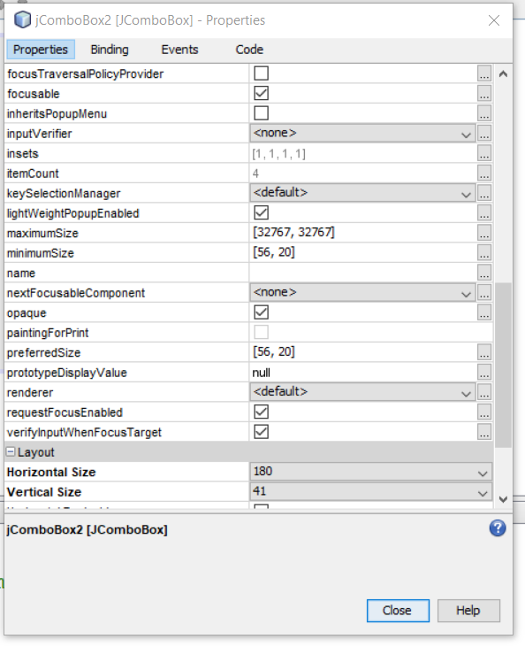
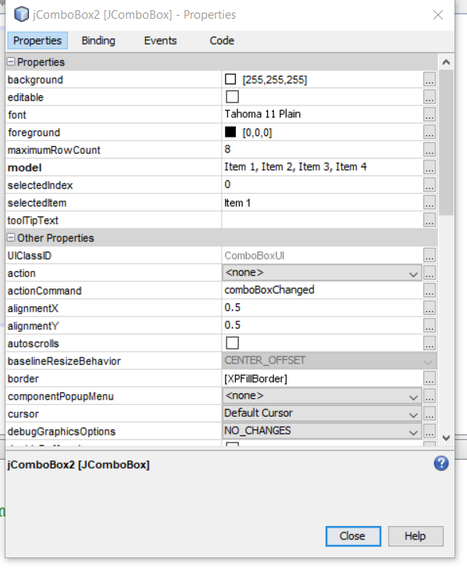
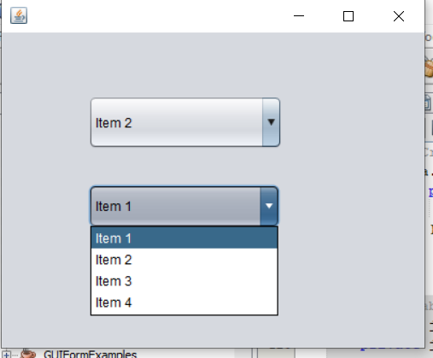
BY
Pasindu Mahima
Search . . .
javax.swing.JComboBox

Slide 14
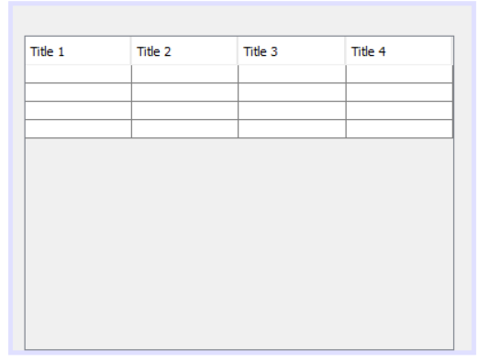
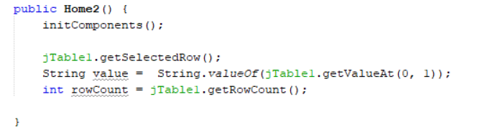
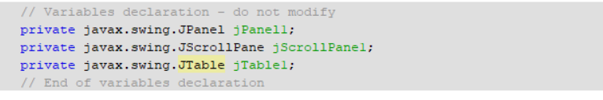
BY
Pasindu Mahima
Search . . .
javax.swing.JTable

Slide 15
BY
Pasindu Mahima
Search . . .
Is JScrollPane necessary when creating a JTable?
The JScrollPane is not strictly necessary when creating a JTable, but it is highly recommended in most cases. A JTable is often used to display tabular data, and if the data exceeds the visible area of the JTable, it becomes essential to use JScrollPane to provide scrollbars for easy navigation.

Slide 16
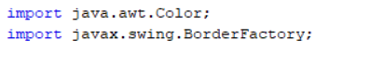
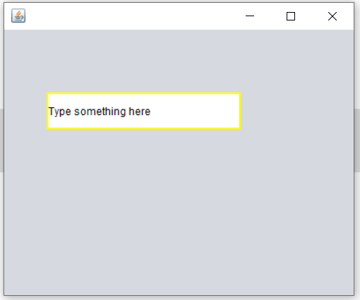
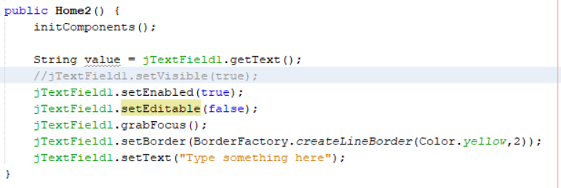
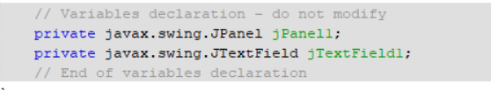
BY
Pasindu Mahima
Search . . .
javax.swing.JTextField

Slide 17
BY
Pasindu Mahima
Search . . .
What is the difference between setEditable and setEnabled?
setEditable(false); lets you copy the content while being uneditable and setEnabled(false); doesn't let you either copy the content or make it editable.

Slide 18
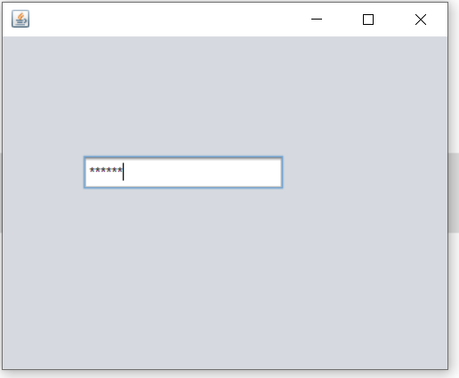
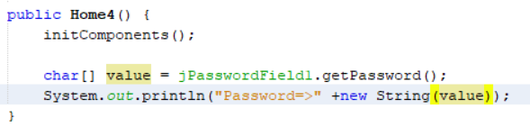
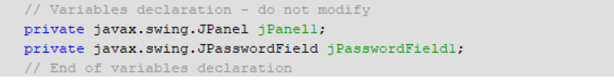
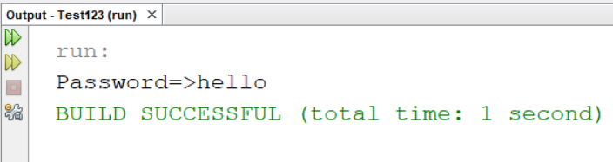
BY
Pasindu Mahima
Search . . .
javax.swing.JPasswordField

Slide 19
BY
Pasindu Mahima
Search . . .
javax.swing.JFormattedTextField

Slide 20
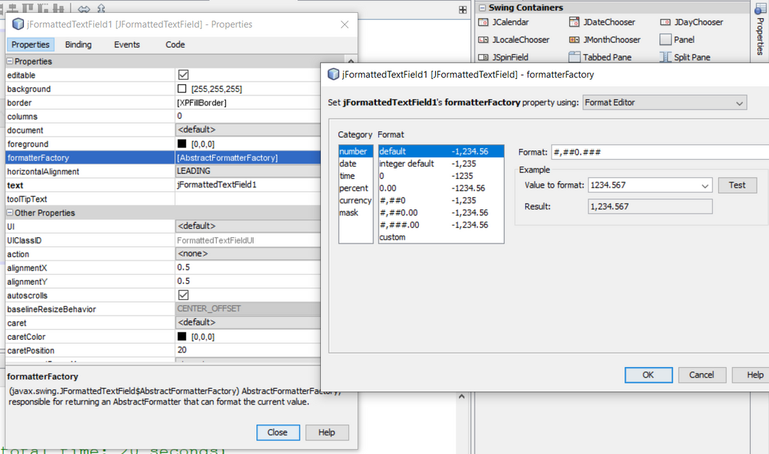
BY
Pasindu Mahima
Search . . .
javax.swing.JFormattedTextField

Slide 21
BY
Pasindu Mahima
Search . . .
What is the difference between jTextField , jPasswordField and jFormattedTextField ?
Use JTextField for general text input.
Use JPasswordField for secure input like passwords.
Use JFormattedTextField when you require input to adhere to a specific format, such as dates or other patterns, and you want to provide automatic formatting and validation for the input.

Slide 22
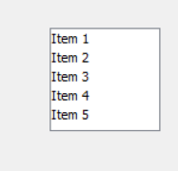
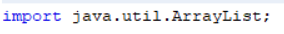
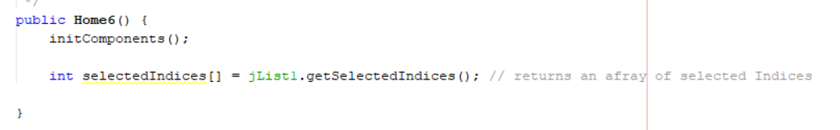
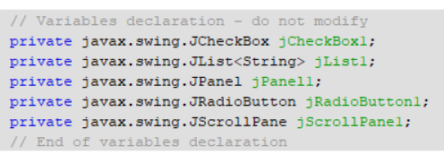
BY
Pasindu Mahima
Search . . .
javax.swing.JList

Slide 23
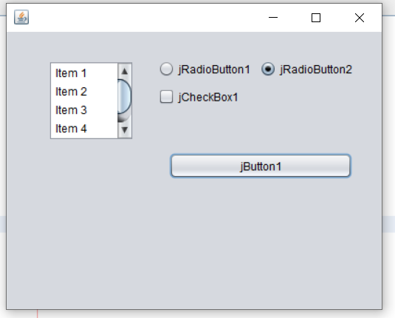
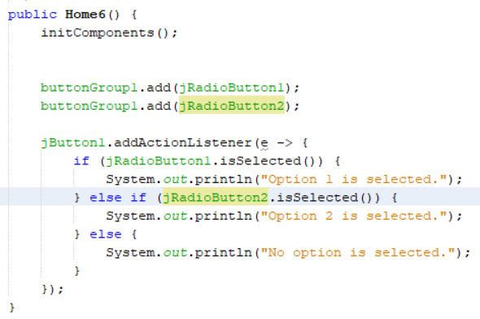
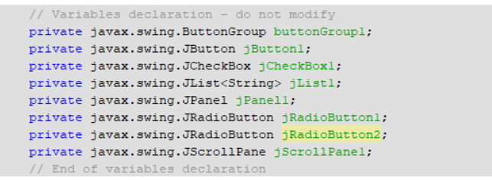
BY
Pasindu Mahima
Search . . .
javax.swing.JRadioButton

Slide 24
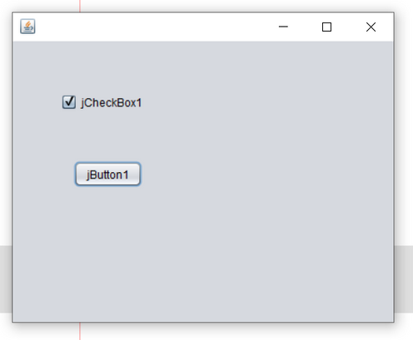
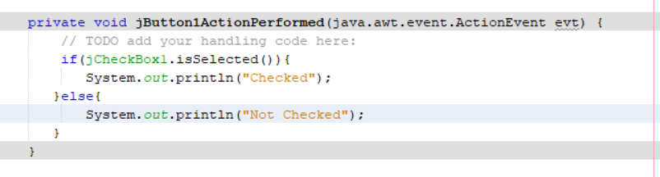
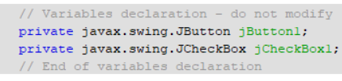
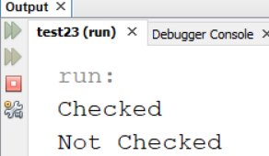
BY
Pasindu Mahima
Search . . .
javax.swing.JCheckBox

Slide 25

BY
Pasindu Mahima
Search . . .
THANK YOU
Social Profiles
Follow Ngator on social networks
Facebook : https://www.facebook.com/learnwithngator
Instagram :https://www.instagram.com/mahimapasindu/
GitHub : https://github.com/drgnhunter
LinkedIn : https://www.linkedin.com/in/pasindu-mahima-3a0031187/
END SLIDE

